Slide 1
Optical Shifts
Optical Shifts
How Flexible is Your Thinking?

Slide 2
How flexible is your thinking?

Slide 3
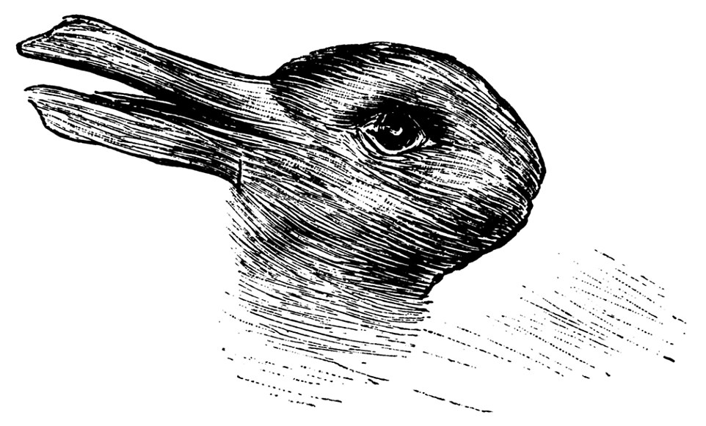
Duck looking left?
Or a rabbit looking right?

Slide 4
A white candle stick?
Or two people facing off?

Slide 5
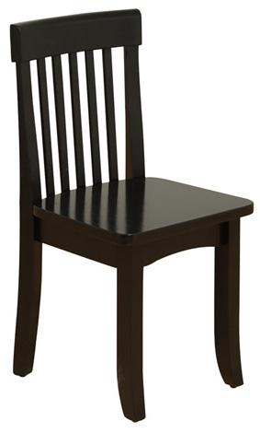
A chair from the front?
Or a chair from the back?

Slide 6
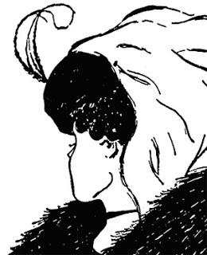
A young woman?
Or an old woman?

Slide 7
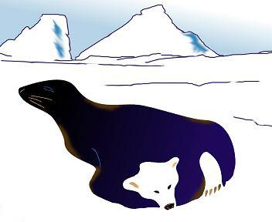
A seal?
Or a bear?

Slide 8
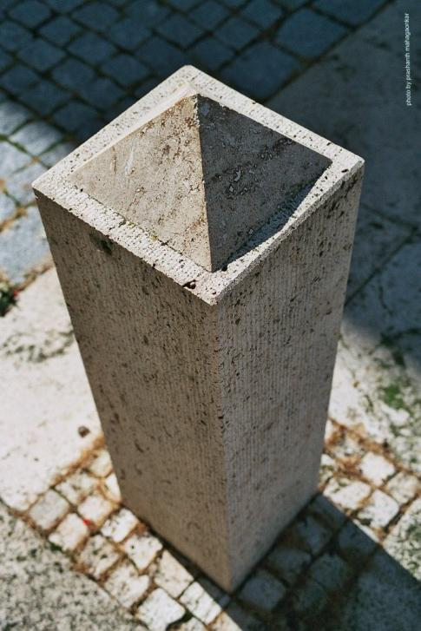
A hollow pillar?
Or a pillar capped
with a pyramid?

Slide 9
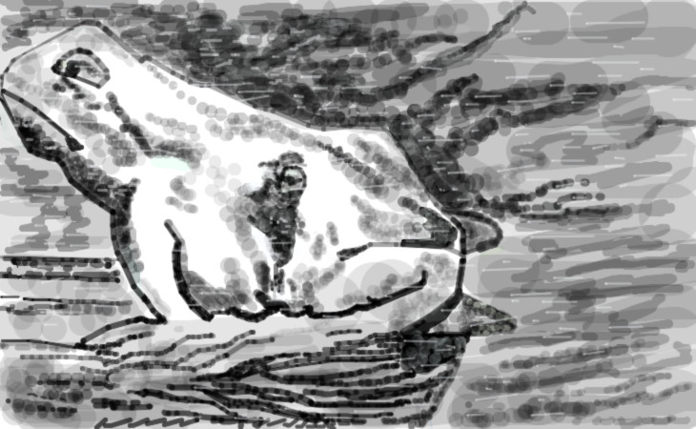
A horse?
Or a frog?

