Slide 1
Marks of Identity

Slide 2
Can you identify this company?

Slide 10
Can you identify the people who dress like this?

Slide 11
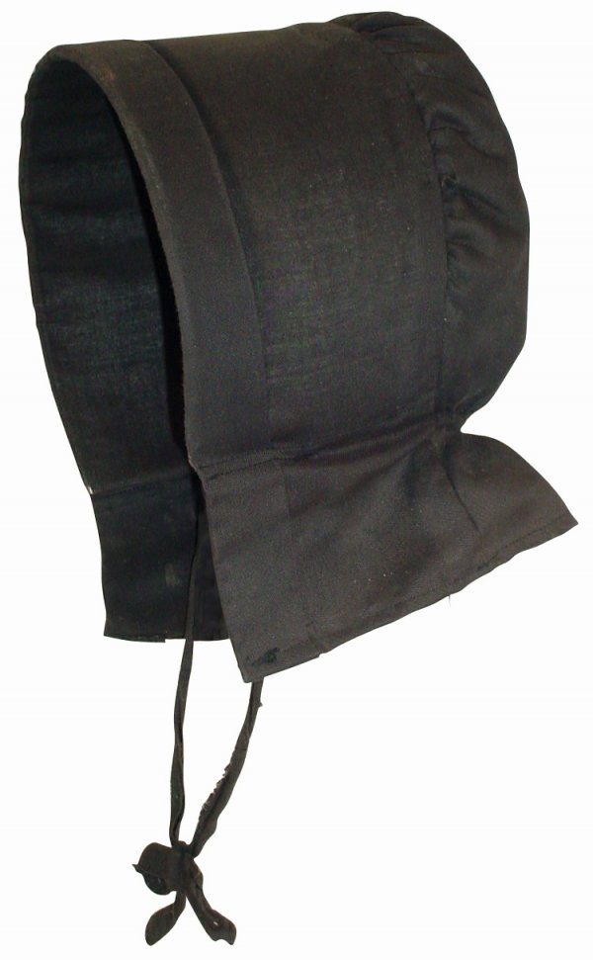

Slide 12
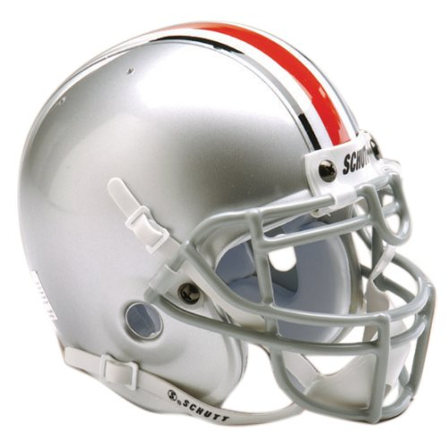

Slide 13
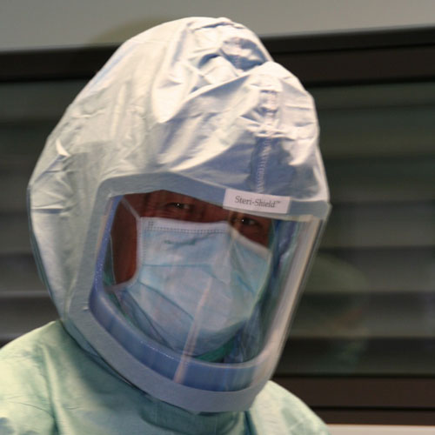

Slide 14
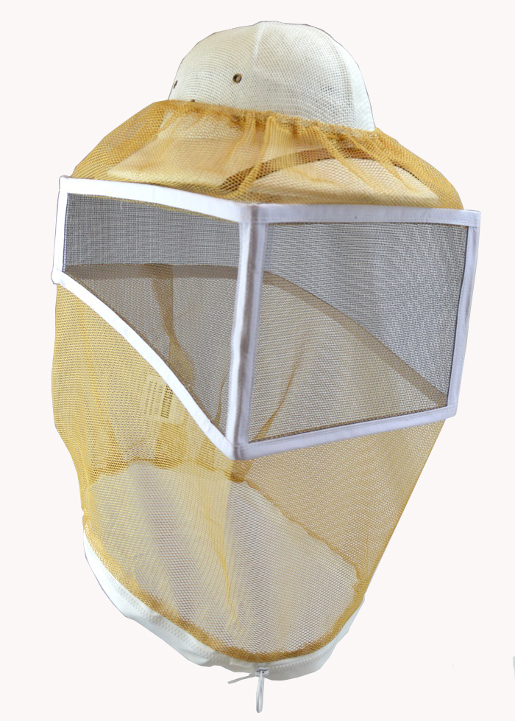

Slide 15
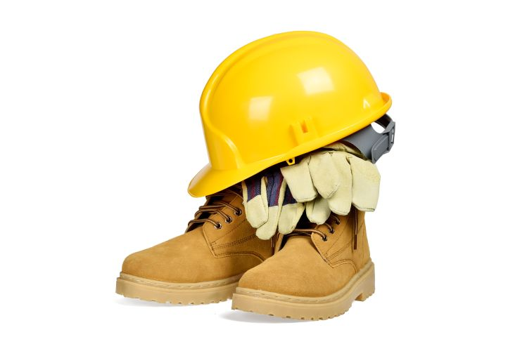

Slide 16
Can you identify these rites of passage?

Slide 19
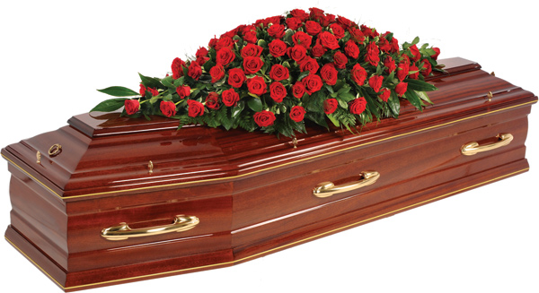

Slide 20
